Slide 1
Space Weather Effects on Satellite Communications
Tim Deaver
Vice President, Hosted Payload Development

Slide 2
A Day Without Space
Most pagers, phones, personal data devices, radios and televisions would become silent
All services leveraging GPS for precise location and navigation would have to come up with another means to determine their exact location
Forecasters would not have access to satellite photos of current weather conditions
Disaster Preparedness agencies wouldn’t have current satellite images
and the list goes on
Page 2
Notes:
Most pagers, phones, personal data devices, radios and televisions would become silent because in one way or another they rely on satellites for the transmission of the information that flows to and from them. All land, sea and air vehicles leveraging the Global Positioning System for precise location and navigation would have to come up with another means to determine their exact location and navigate from where they are to where they want to go. Weather forecasters would not have access to satellite photos of current weather conditions around the world and in their local areas. Mapmakers wouldn’t have current satellite images from which to update their products

Slide 3
Outline
The Effects of the Space Environment on Communications Satellites
Examples of Space Environmental Effects – Halloween Geomagnetic Storms Oct / Nov 2003
Space Environment Sensors on SES Operated Spacecraft: CEASE II and CPA
Space Environment Sensors as hosted payloads
Availability of Data from Space Environment Sensors
What DOES the Future Have in Store for us?
Page 3

Slide 4
Effects of the Space Environment on Communications Satellites
Spacecraft ‘Anomalies’ = non-nominal behavior or performance
Degradation of solar arrays
Spurious events not affecting commercial services (telemetry state changes, uncommanded equipment turnoff)
Spurious events affecting commercial services (e.g. amplifier Spurious Turnoff)
Solar array circuit failure
Earth / Star Sensor noise
Attitude disturbances
Etc.
Page 4

Slide 5
Cause of Space Environment Related Anomalies
Solar array degradation – high energy protons / electrons;
Spurious events
Surface charging – low energy electrons
Deep Dielectric / Internal Charging – high energy (>2MeV?) electrons
Single Event effects – high energy protons / heavy ions
Solar array circuit failures – surface charging / ESD, interaction with thruster plumes?
Sensor noise – high energy protons
Attitude disturbances
Plasma ejection during solar array ESD
Geomagnetic field disturbances (spacecraft with magtorquers)
Page 5

Slide 6
Spacecraft Anomalies – Annoyances, Often Easy to Overcome….However…..
Most Spacecraft Anomalies caused by the Space Environment are:
An annoyance
Easily mitigated by careful spacecraft design (redundancy, sufficient design margin, signal filtering) and robust operations (highly trained, experienced and vigilant operations staff)
But more significant anomalies and failures do occur, such as, but not limited to
Anik E1 & E2, 20 Jan 1994 (spacecraft eventually recovered to operation);
Telstar 401, 11 Jan 1997
Galaxy 15, Easter 2010 (spacecraft eventually recovered to operation)
Page 6

Slide 7
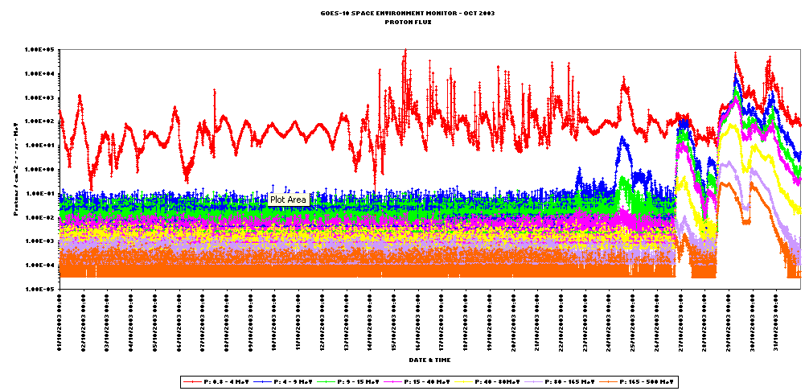
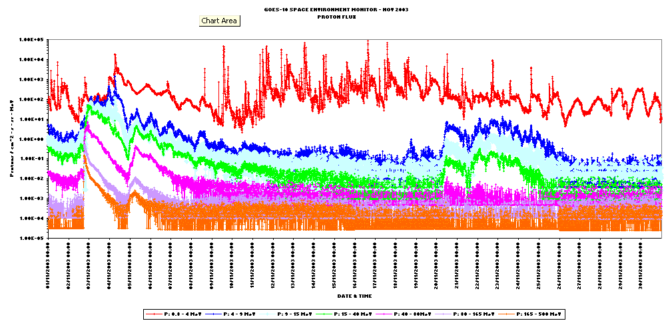

Halloween Geomagnetic Storms Oct / Nov 2003
Page 7

Slide 8
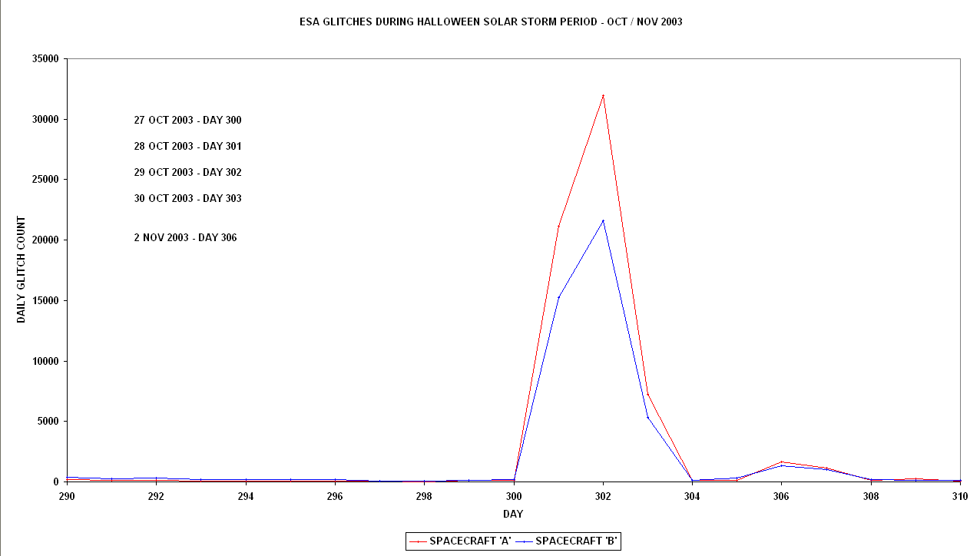
Examples……Halloween Geomagnetic Storms Oct / Nov 2003 – Earth Sensor Noise
Page 8

Slide 9
Space Environment Sensors on SES Operated Spacecraft : CEASE II and CPA
SES operates 44 satellites at geosynchronous orbit
Three satellites carry small Space Environment Sensor Packages
One CEASE II (Compact Environmental Anomaly Sensor)
NSS-10 (38.5°W)
Two CPA (Charge Plate Assembly) / Dosimeter packages
NSS-806 (40.5°W), NSS-5 (20°W)
The CEASE II package consisting of 3 individual sensors
Electro - Static Analyzer measuring low energy electrons
Dosimeter package measuring overall radiation dose and dose rate
Particle Telescope measuring higher energy protons and electrons
The CPA measures the surface charging (voltage) built up on an insulated aluminum plate on the outside of the spacecraft
Page 9

Slide 10
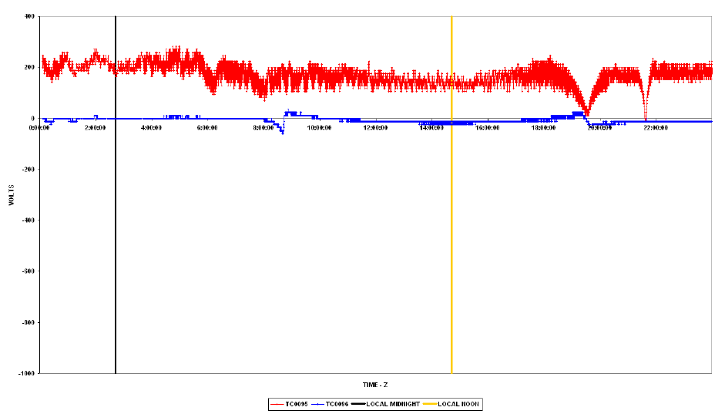
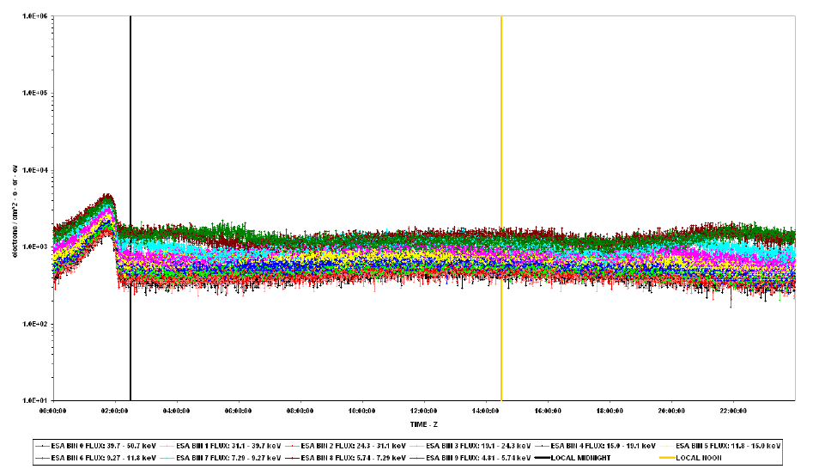
CEASE & CPA Observations – 1 – A Quiet Day
The CEASE sensor is located between but close to the two CPA equipped spacecraft, allowing cross-correlation of the data.
Page 10

Slide 11
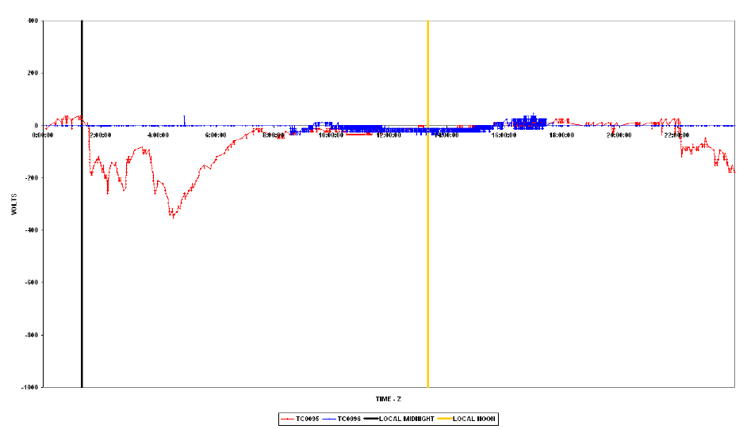
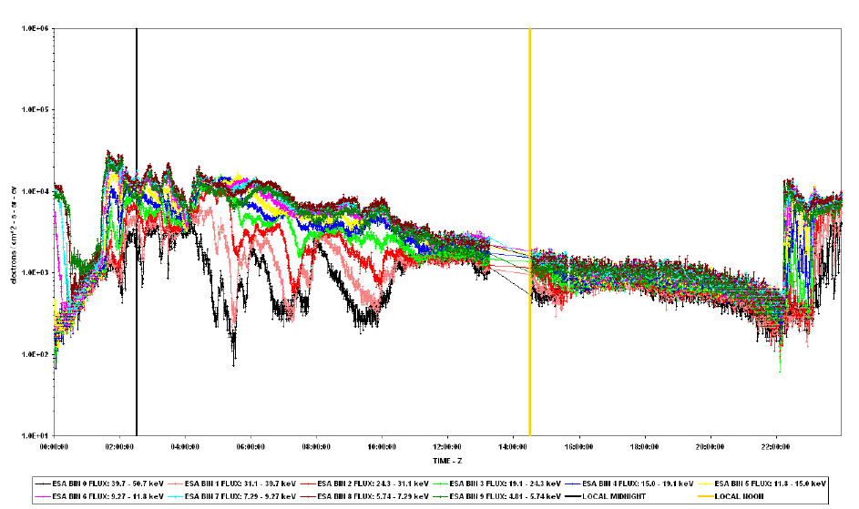
CEASE & CPA Observations – 2 – A Less Quiet Day
Page 11

Slide 12
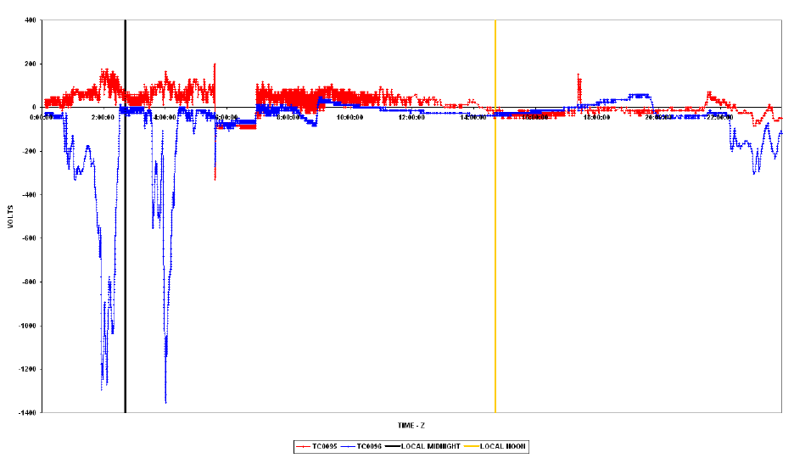
CEASE & CPA Observations – 3 – A Charging Event From Solar Cycle 23 Maximum
Day 310, 6 Nov 2010. As reported by NOAA SWPC (then SEC) in the RSGA:
‘The geomagnetic field was at unsettled to severe storm conditions. The full-halo coronal mass ejection (CME) from the 04 November event impacted the geomagnetic field at 06/0150 UTC………..Severe geomagnetic storming occurred between 06/0000 and 06/0600 UTC and 15 – 1800 UTC.’
Page 12

Slide 13
Space Environment Sensors Hosted on Commercial Spacecraft
Modern Space Environment sensors are small, lightweight and have a very small power consumption
Such sensors – the best example is CEASE II – provide very useful environmental data to the spacecraft operator
The data provided by such sensors improves Situational Awareness and helps improve the robustness of Spacecraft Operations
It is recommended that other operators host similar sensors
Data sharing protocols should be developed to allow transfer of Space Environment data between operators
Page 13

Slide 14
Availability of Data from Space Environment Sensors
Data from Space Environment Sensors is critical to robust Spacecraft Operations
The prime sources are the operational GOES satellites GOES – 13 & 15
LANL (Los Alamos National Laboratory) SOPA / MPA
Was very useful
MPA – low energy electron channels - very useful for Surface Charging Effects
Since Feb 2008, LANL data has not been available to non - US Govt agencies
Long term, assured access to particle sensor data is a concern – we need more sensor assets in orbit
Space Environment Sensors are ideal for hosting on commercial telecom satellites
Page 14

Slide 15
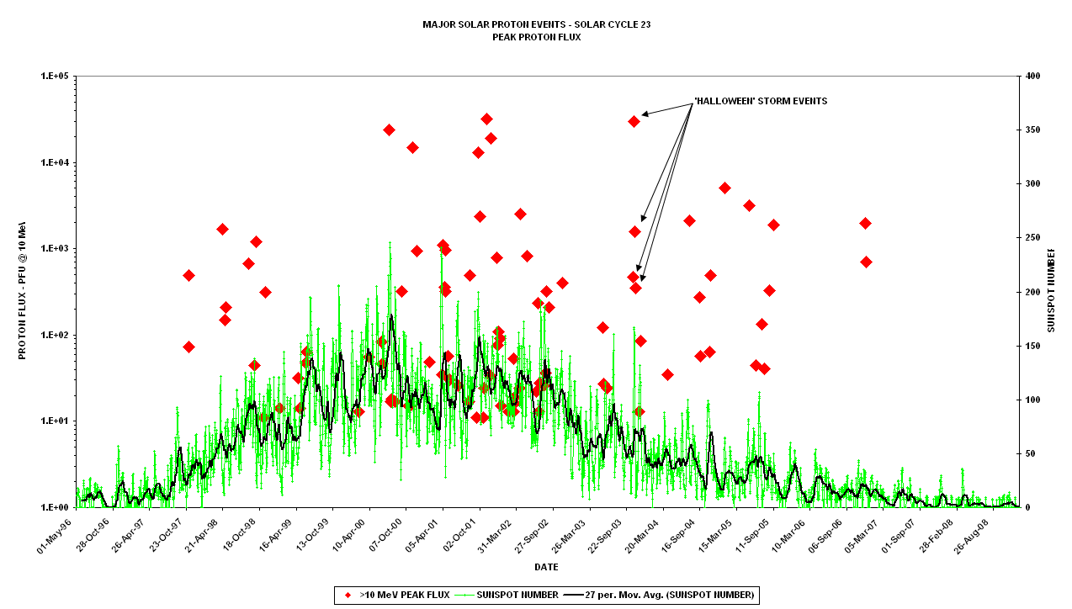
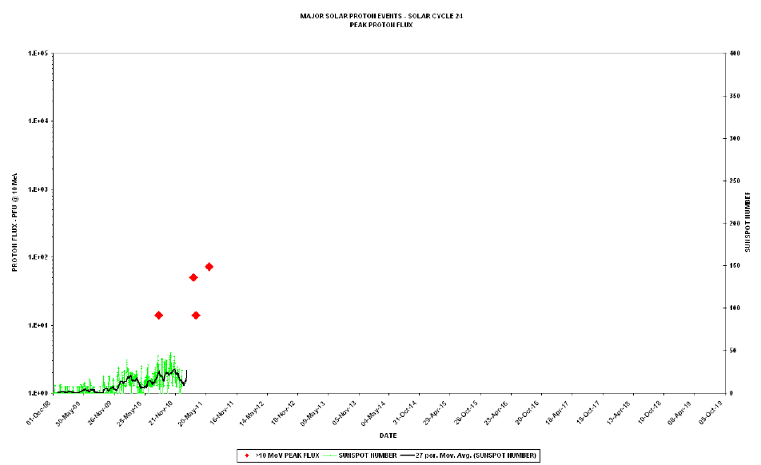
What DOES the Future Have in Store for us?
The Space Environment has been very benign for quite some time now
Last significant Proton Events of Solar Cycle 23 were in December 2006
First Proton Event of Solar Cycle 24 was in August 2010, most significant event so far was 7 June 2011 (albeit still a very minor event)
Page 15

Slide 16
Any Questions?
Dave Pitchford
Dave.pitchford@ses.com
Tim Deaver
Timothy.deaver@ses-usg.com
Page 16

